Slide 1

AMCAT Data Analysis
By:
B.B S R GANESH

Slide 2
About me
Name: B.Bharani surya raja ganesh
Qualification: B.COM(CA)
I want to learn Data Science because it allows me to transform raw data into actionable insights, enabling smarter decision-making and driving innovation across industries.
Experience: Data Science Internship – Innomatics Research Labs -- (August-)
LinkedIn :
linkedin.com/in/raj-ganesh-2115462a3
GitHub:
https://github.com/rajganesh444

Slide 3
Agenda:
Business Problem:
The goal is to analyze the factors influencing employment outcomes (such as salary, job titles, and job locations) for engineering graduates. By understanding how cognitive, technical, and personality skills impact these outcomes, educational institutions and recruiters can optimize training programs and hiring strategies.
Objective of the project :
identify and analyze the key factors that influence the employment outcomes of engineering graduates, such as salary, job titles, and job locations, based on their cognitive, technical, and personality skills.

Slide 4
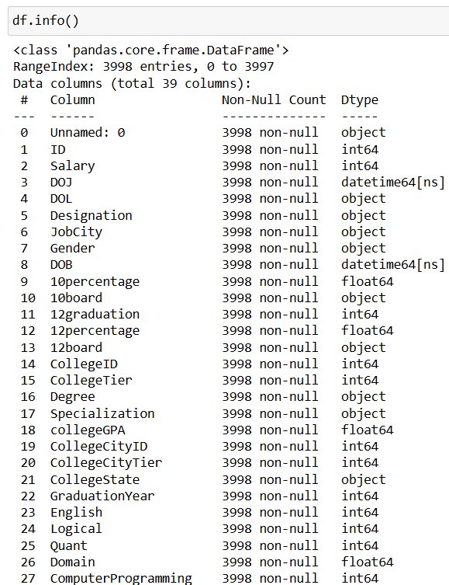
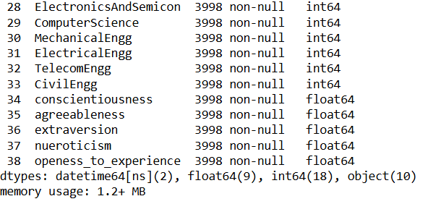
Summary of the Data

Slide 5
Univariate Analysis
Distribution of Continuous Variables:
Salary: Analyze the distribution of salaries among graduates to identify common salary ranges, outliers, and overall skewness.
Standardized Scores: Examine the distribution of cognitive, technical, and personality skill scores to assess the general skill levels of the graduates.
Categorical Variables:
Job Titles: Identify the most common job titles among engineering graduates.
Job Locations: Determine the most frequent job locations to understand geographic employment trends.
Demographics: Analyze demographic features (such as gender, and region) to observe trends in the dataset, such as gender representation in engineering fields.
Frequency Counts:
Count the occurrences of each category within categorical variables to identify dominant categories (e.g., most common engineering discipline).
Central Tendency and Dispersion:
Calculate measures of central tendency (mean, median) and dispersion (standard deviation) for continuous variables like salary and skill scores.
Outliers Detection:
Identify and evaluate outliers in salary and skill scores to understand extreme cases and their potential impact.
Missing Values:
Assess the extent of missing data within each variable to determine if imputation or exclusion is necessary.
This univariate analysis helps in understanding the basic characteristics of the dataset and sets the stage for further analysis.

Slide 6
Bi – Variate Analysis
Gender vs. Salary: Investigate any gender-based salary disparities to understand the gender wage gap in engineering employment.
English vs. Quant: This analysis helps in understanding the relative importance of English and quantitative skills in shaping employment outcomes.
Gender vs. specialization: Analyze the distribution of specializations (e.g., Computer Science, Mechanical Engineering, Electrical Engineering) among male and female graduates to identify any gender-specific trends in choosing specializations.
Salary vs. College GPA: Higher college GPA often correlates with better-starting salaries, as it can reflect strong academic performance and skills sought after by employers.

Slide 7
Conclusion
Based on the given features, those likely to affect salary include:
Designation: The job title or role often has a significant impact on salary
College Tier: The tier of the college can influence the starting salary, with higher-tier colleges often leading to better-paying jobs.
Quant, Logical, and Computer Programming Skills: Proficiency in these areas is crucial for technical roles and can lead to higher salaries.

Slide 8

THANK YOU

